Slide 1
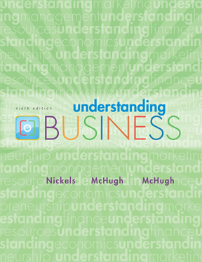
*
Chapter Seven
*
Management and Leadership
Tania Akter (TAK)
McGraw-Hill/Irwin
Copyright © 2010 by The McGraw-Hill Companies, Inc. All rights reserved.

Slide 2
PLANNING ANSWERS
FUNDAMENTAL QUESTIONS
*
Planning & Decision Making
*
LG3
  What is the situation now?
    SWOT Analysis -- Analyzes the organization’s Strengths, Weaknesses, Opportunities and Threats.
  How can we get to our goal from here?
    Strategic planning
    Tactical planning
    Operational planning
    Contingency planning
7-<number>

Slide 3
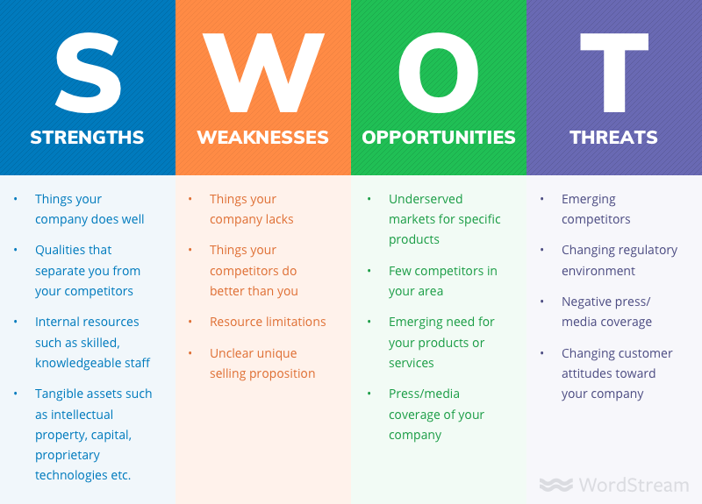

Slide 4
Potential Strengths Market leadership Strong research and development High-quality products Cost advantages Patents | Potential Weaknesses Large inventories Excess capacity for markets Management turnover Weak market image Lack of management depth
Potential Opportunities New overseas markets Falling trade barriers Competitors failing Diversification Economy rebounding | Potential Threats Market saturation Threat of takeover Low-cost foreign competition Slower market growth Growing government regulation

Slide 5
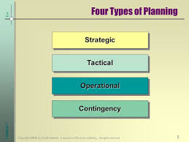
Four types of Planning
  How can we get to our goal from here?
    Strategic planning
    Tactical planning
    Operational planning
    Contingency planning

Slide 6
STRATEGIC and TACTICAL
PLANNING
*
Planning & Decision Making
*
LG3
Strategic Planning -- Done by top management and determines the major goals of the organization and the policies, procedures, strategies and resources it will need to achieve them.
Tactical Planning -- The process of developing detailed, short-term statements about what is to be done, who is to do it and how.
7-<number>

Slide 7

OPERATIONAL and CONTINGENCY PLANNING
*
Planning & Decision Making
*
LG3
Operational Planning -- The process of setting work standards and schedules necessary to implement the company’s tactical objectives.
Contingency Planning -- The process of preparing alternative courses of action the firm can use if its primary plans don’t work out.
7-<number>

Slide 8

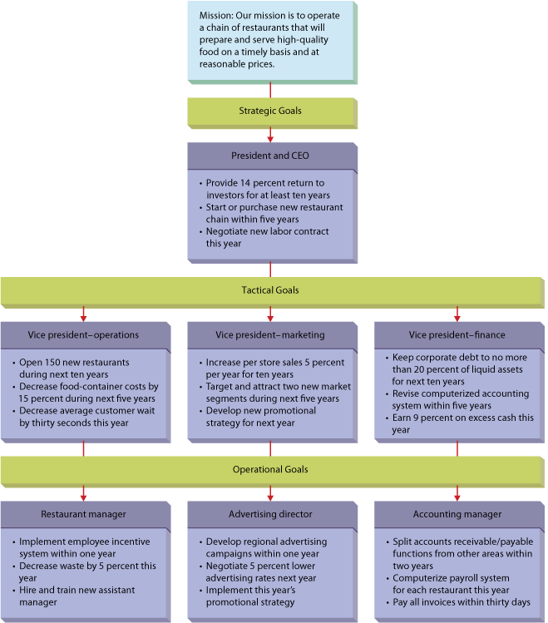
7.2
Kinds of Organizational Goals for a Regional Fast-Food Chain
7–<number>
Notes:
© 2013 Cengage Learning. All rights reserved. May not be copied, scanned, or duplicated, in whole or in part, except for use as permitted in a license distributed with a certain product or service or otherwise on a password-protected website for classroom use.
7–<number>
Management 11e
Griffin

Slide 9
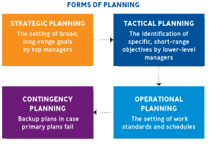
PLANNING FUNCTIONS
*
Planning & Decision Making
*
LG3
7-<number>

